Slide 1
Clubs & Societies AGM
Monday 9th March 2020

Slide 2
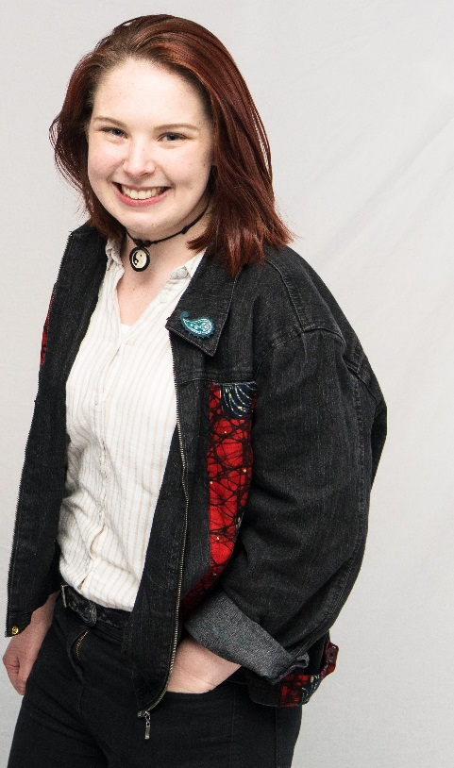
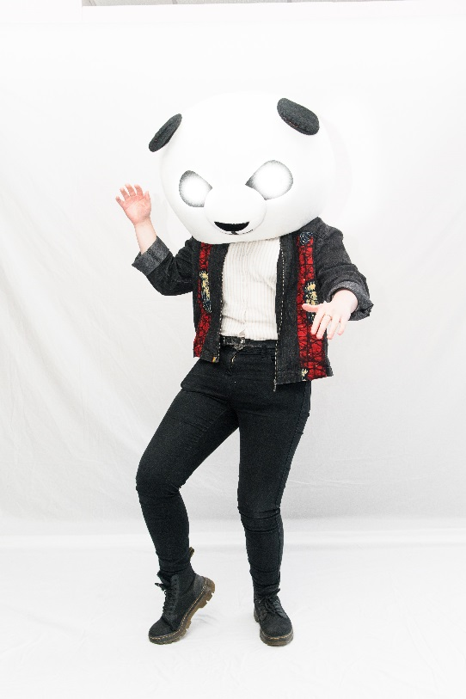
Welcome Back!

Slide 3
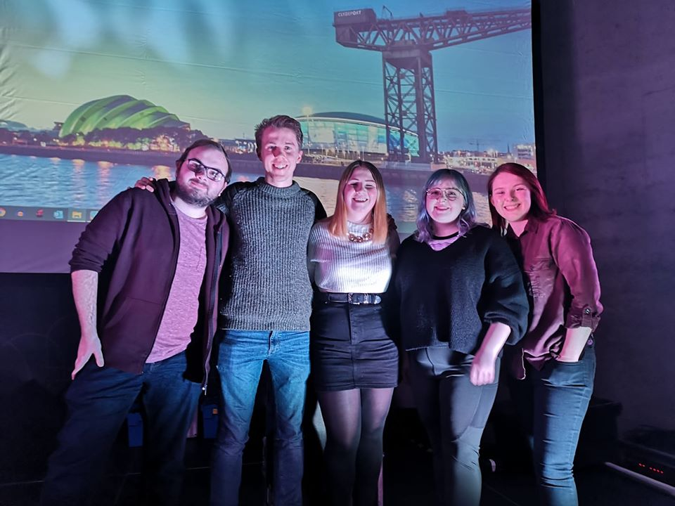
2020/21 Full Time Officer Team

Slide 4
Building Move Survey Summary:

Slide 9
REMEMBER:
TELL US WHAT YOU WOULD LIKE US TO TAKE TO THE NEW BUILDING! VISIT LEVEL 7 AND PICK UP SOME STICKERS

Slide 10
Budget Update
Clubs Exec
Total expenditure: £24,969.31
Total remaining grant: £10,030.69
Arts and Culture
Total expenditure: £18,086.51
Total remaining Arts and Culture grant: £11,913.49

Slide 11
Clubs Exec Election
The Clubs and Societies Executive Committee (or ‘Clubs Exec’), consists of the full-time Vice President Community and 6 students who are elected annually. The Committee has the power to approve society affiliations and make decisions on the allocation of a £65,000 budget.
The role of each member is to assist and support the committees of over 200 clubs and societies, develop opportunities, and promote activities. You’ll do this by attending our Clubs Exec meetings and Clubs and Societies General Meetings.
Voting members shall consist of the Clubs and Societies Executive Committee and one representative of each affiliated club and society who will each have one vote per society; if an attendee is a member of more than one society’s committee they are still only entitled to a single vote.

Slide 12
Your Candidates
Phineas Chiketsani
Thomas Lam
Sheik Malik
Laura Milligan
Liam Mosson
Ellie Swanston
Madeleine Taylor
Stephen Ugwuanyi
R.O.N

Slide 13
Phineas Chiketsani
“I think I'd be a good candidate for the role because I have served as President of the Strathclyde Trading and Portfolio Management Society for nearly a year, and have nearly two years of experience in the Asset Management industry. Through these experiences, I have developed proficiency in capital budgeting, and have collaborated with a range of societies in the Union. I hold a BA (Hons) in Accounting and Finance, and am involved in a range of volunteering and charitable activities. While the qualifications listed above outline my competence for the role should I be selected, I believe my ability to work in a team and make objective decisions for the overall good of a variety of stakeholders qualify me for this role”

Slide 14
Thomas Lam
“I want to be elected to Clubs Exec, because throughout my time at Uni and Strath TV, I have showed very strong levels of Commitment during all of our projects. I am perseverant and will always get the job done. I excel at interpersonal interactions as I have been a Intake Caller for the Mediation Clinic for four months and been praised for it”

Slide 15
Sheik Malik
“Since joining Strathclyde a year ago, I have setup 3 clubs and societies. Strathclyde University Hot Air Ballooning society, Strathclyde Speakers and re-affiliated TEDxUniversityofStrathclyde. I strongly believe clubs and societies are the essential part of what make students experience at University unique and memorable. Providing useful experience and skills to go on and have successful career.
I want to use my experience to help all the different amazing clubs at Strathclyde to achieve incredible things! And promote greater collaboration between clubs”

Slide 16
Laura Milligan
“I would like to run for a Club Exec position, I think it sounds like a great opportunity!! I think I’d be good in the role, because I am a committed and hard-working student/committee member for my Society. I started Strathclyde Musical Theatre Society in 2019, and we have had a very successful first year! I am a friendly, outgoing person and an effective team member. I’m level-headed and would make fair and impartial decisions with the rest of the Club Exec Team. Having started the Strathclyde Musical Theatre Society, and running it in it’s first year as President, I think it puts me in a position where I could help other newly formed societies by suggesting steps they should take when starting out and ensuring they get the right support”

Slide 17
Liam Mosson
“I am on the Strathclyde Model United Nation's committee as social media secretary and I would just like to state my intention to stand for a place on the clubs and societies executive committee.
I am standing for the committee position in order to invoke fresh insight to the committee, drawing on my experience from being a class representative, election candidate and an avid enthusiast for the development of clubs and societies at Strathclyde”

Slide 18
Ellie Swanston
“After joining Girl up in first year and now having been President for this year, I've become a lot more involved with the union and I am really interested in finding out about how it works! I also want to help other clubs and societies because I know I wouldn't have been able to apply for grants if it wasn't for Sophie being our VP!”

Slide 19
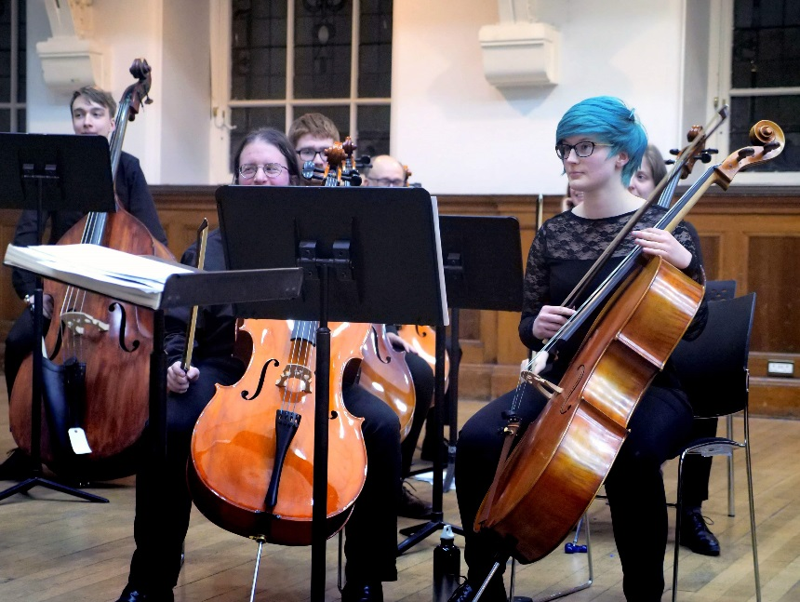
Madeleine Taylor
“I've really enjoyed being a member of a club and I found being a committee member rewarding so I would like to continue to take on a responsibility at the Union. My experience of being the Treasurer for SUSO (Strathclyde University Symphony Orchestra) for two years has prepared me well to be a part of the clubs exec committee. I'd enjoy it and I think I've got the necessary experience to do a good job (after writing lots of grant requests for Clubs Exec to approve in the past). I'm excited at the idea of being a part of it because I understand how much grants can do to help societies and the opportunities that they can create. ”

Slide 20
Stephen Ugwuanyi
“I have taken up a good number of volunteer roles within the Strath Union since 2016. Being in the third year of my PhD, I still want to remain active within the Strath Union activities but with limited commitment. I want to contribute my years of experience to the effective running of club exec”

Slide 21
VOTING INSTRUCTIONS
Each Society is to rank Candidates in order of preferences, where ‘1’ is your first choice, ‘2’ is your second choice, and so on
You may show as many or a few preferences as you wish up to the total number of candidates standing for election
Re-open nominations (RON) means that you wish to re-run the election

Slide 22
Active and engaged
Log all volunteer hours on the website for achieving this here: https://www.strathunion.com/volunteering/profile/
Update your clubs active and engaged status by April 30th at: https://www.strathunion.com/clubs-socs/activeengaged/correctionform/
Notes:
All clubs and socs should now be active and on their way to being engaged.
Once you are active and have logged 20 hours, committee members can get a 10% union discount card – don’t forget to use it!
Addition of handover doc to active and engaged this year – a template for this is available online now and you should already be filling this out with your experiences from this year – any problems come and chat.

Slide 23
Congratulations to our societies who are already accredited!
Catholic Society
Strath Speechies
Strathclyde Piping Society
Strathclyde Telegraph
Girl Up Strathclyde
LGBT+ Society
Red Strathclyde
Piano Society

Slide 24
Active and Engaged Updates
We will add an Active and Engaged badge to all societies who are accredited by 30th April in time for Freshers’ 2020!
We will transfer £40 into your bank account straight away – no need to wait until the prize draw!
We are still investigating whether Active and Engaged societies can appear first on our “Find Club or Society” page

Slide 25
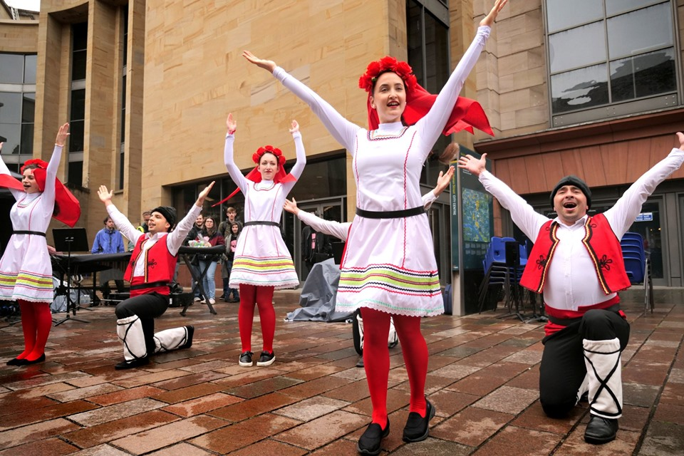
Arts Fest

Slide 26
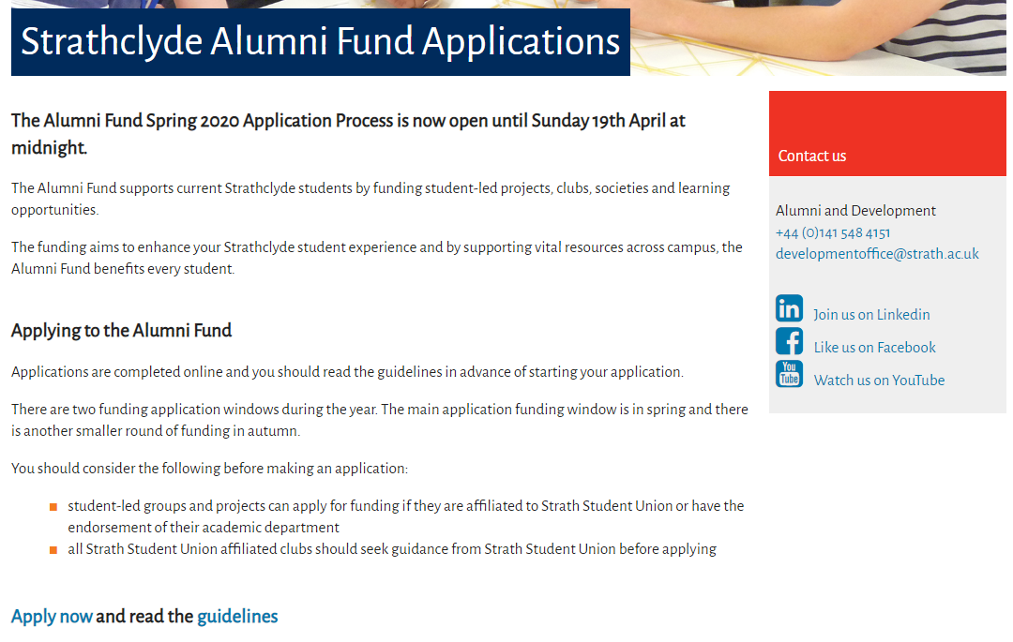
Alumni Fund

Slide 27
Participation Fund
Provides financial contribution towards activities that enhance the student’s experience or development, but are not essential parts of their course
Priority will be given to students who are:
Parents | Students from low income households
Carers | Disabled students
Care experienced students | Refugees
Estranged/independent students | From other widening access backgrounds

Slide 28
Clubs Exec Accountability
Questions to the clubs exec on their decisions regarding the minutes of the meetings, society affiliations, and grant requests

Slide 29
Questions?

